Slide 1
Mountain Bike
Accessories Sales
Analysis Dashboard
Comprehensive Business Intelligence Report
PRESENTED BY : SUGANYA M
Powered by Power BI | Data-Driven Decision Making
112K Customers
$85M Revenue
1.3M Units Sold
38% Profit Margin

Slide 2
Table of Contents
01
Project Overview & Objectives
11
Purchasing Behavior by Gender
02
Problem Statements
12
Age Group Revenue Contribution
03
Dataset & Data Model
13
Impact of Cost on Profitability
04
Key Performance Indicators
14
State-wise Revenue by Country
05
Revenue vs Profit by Category
15
Dashboard Overview Page 1
06
Revenue by Country
16
Dashboard Overview Page 2
07
Sub-Category Sales Performance
17
Data Model Architecture
08
Category-wise Profit Comparison
18
Business Insights
09
Avg Order Value by Category
19
Recommendations
10
Category Performance Analysis
20
Thank You

Slide 3
Project Overview & Objectives
OBJECTIVE
KEY ANALYSIS AREAS
To analyze sales performance, customer demographics, product trends, and profitability using historical bike accessories sales data to support strategic business decisions.
Revenue & Profit Performance
Geographic Analysis
Customer Demographics
SCOPE
Product & Sub-Category Trends
• 113,036 sales transactions
• 6 Countries analyzed
• 3 Product Categories
• Years: 2013 to 2016
Profitability & Cost Analysis
KPI Monitoring & Benchmarking

Slide 4
Problem Statements
Main Problem Statement
How can Mountain bike accessories sales data be analyzed to evaluate revenue performance, identify top-performing products and regions, understand customer buying patterns, and improve overall profitability?
1
Which country generates the highest revenue?
7
Which states perform better within each country?
2
Which product category contributes the most profit?
8
Identify underperforming product categories.
3
Which sub-category has the highest sales volume?
9
How does cost impact overall profitability?
4
Which age group contributes the most revenue?
10
Compare revenue vs profit across categories.
5
Is there a significant difference in purchasing behavior based on gender?
11
Identify key performance indicators affecting business growth.
6
What is the average revenue per order?

Slide 5
Dataset & Data Model Architecture
Bike_Sales_Dataset Columns
Star Schema Data Model
Date, Day, Month, Year
Time dimension
FACT TABLE
Bike_Sales_Dataset
Customer_Age, Age_Group
Demographics
Customer_Gender
Gender (M/F)
Country, State
Geographic data
Dim_Geography
(Country, Country_ID)
Dim_Product
(Product, Category,
Sub-Category)
Product_Category
Bikes/Accessories/Clothing
Sub_Category, Product
Product detail
Dim_Date
(Date, Month, Year)
Order_Quantity
Units ordered
Unit_Cost, Unit_Price
Pricing info
Profit, Cost, Revenue
Financial metrics
Star Schema: Bike_Sales (Fact) linked to Dim_Product, Dim_Date, Dim_Geography

Slide 6
Key Performance Indicators (KPIs)
Total Customers
Total Revenue
Total Profit
Total Cost
112K
$85.3M
$32.2M
$53.1M
Unique records
All categories
Net profit
Operating cost
Total Units Sold
Profit Margin
Top Country
Top Product
1.3M
37.8%
USA
Water Bottle
Order quantity
Profit/Revenue
$28M revenue
164K units sold

Slide 7
Revenue vs Profit by Product Category
Bikes
Revenue: $61.8M
Profit: $20.5M | Margin: 33.2%
Accessories
Revenue: $15.1M
Profit: $8.9M | Margin: 58.6%
Clothing
Revenue: $8.4M
Profit: $2.8M | Margin: 33.9%

Slide 8
Highest Revenue by Country
United States
Revenue: $28.0M
Share: 32.8%
Australia
Revenue: $21.3M
Share: 25.0%
United Kingdom
Revenue: $10.6M
Share: 12.5%
Top Performing Country: United States ($28M)

Slide 9
Sub-Category Sales Performance
Tires & Tubes leads with 514K units — 38% of all accessories sold

Slide 10
Category-wise Profit Comparison
Bikes
Profit: $20.5M | Share: 63.7%
Accessories
Profit: $8.9M | Share: 27.5%
Clothing
Profit: $2.8M | Share: 8.8%
Total Profit: $32.2M — Bikes is the Most Profitable Category

Slide 11
Average Order Value by Category
Key Insights
Bikes
Avg: $1,650
26x higher — premium segment
Clothing
Avg: $85
Low-ticket, volume revenue
Accessories
Avg: $63
High-volume, low avg ticket
Overall Avg Revenue/Order: $63.60

Slide 12
Purchasing Behavior by Gender
Male Customers
Units Sold: 699,583
Share: 52.0%
Slightly higher purchase volume
Female Customers
Units Sold: 645,733
Share: 48.0%
Nearly equal purchasing power
Both genders show nearly equal behavior — marketing should remain inclusive.

Slide 13
Age Group Revenue Contribution
Adults (35-64)
$42.6M (49.9%)
Core revenue driver — primary target
Young Adults (25-34)
$30.7M (35.9%)
High growth potential segment
Youth (<25)
$11.7M (13.7%)
Emerging — brand loyalty focus
Seniors (64+)
$0.3M (0.4%)
Niche — specialized products

Slide 14
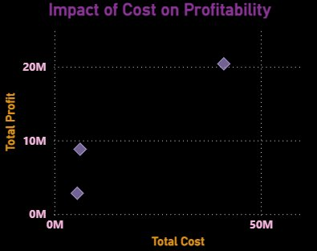
Impact of Cost on Profitability
Cost-Profit Analysis
Bikes
Cost: $39.2M | Profit: $20.5M
Margin: 33.2%
Accessories
Cost: $6.3M | Profit: $8.9M
Margin: 58.6%
Clothing
Cost: $7.6M | Profit: $2.8M
Margin: 33.9%
Accessories: Best ROI despite lower absolute profit

Slide 15
Category Performance Analysis
Metric | Bikes | Accessories | Clothing
Total Revenue | $61.8M | $15.1M | $8.4M
Total Profit | $20.5M | $8.9M | $2.8M
Profit Margin | 33.2% | 58.6% | 33.9%
Units Sold | ~200K | ~1.05M | ~90K
Accessories have the highest profit margin (58.6%) despite lower revenue — strong cost efficiency

Slide 16
State-wise Revenue Performance by Country
United States
Australia
Top States: California, Washington, Oregon — Top 3 states
Top States: New South Wales, Victoria, Queensland
United Kingdom
Germany
Top States: England (London region leads)
Top States: Bayern, Brandenburg, Hessen
France
Canada
Top States: Ile de France, Nord, Oise
Top States: British Columbia, Ontario, Alberta
US leads in both total revenue and geographic distribution — most diverse market

Slide 17
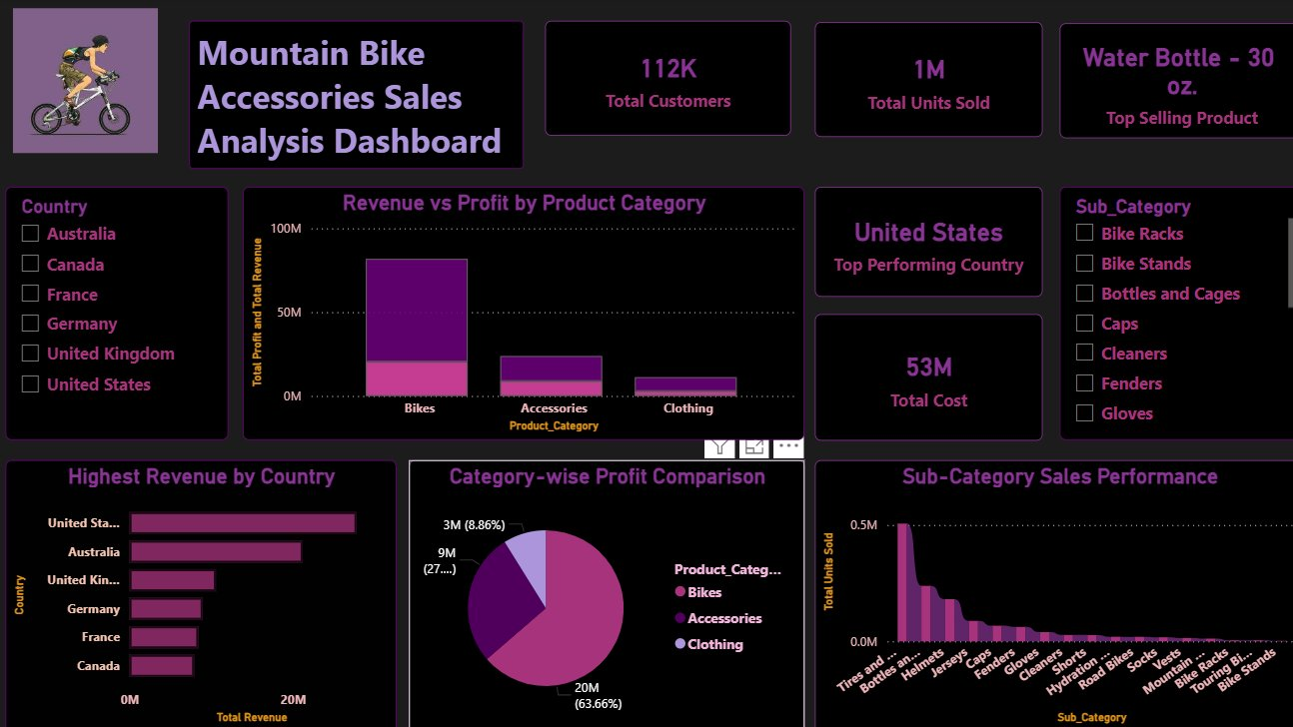
Power BI Dashboard — Page 1: Sales Analysis
Dashboard Page 1 — Mountain Bike Accessories Sales Analysis Overview

Slide 18
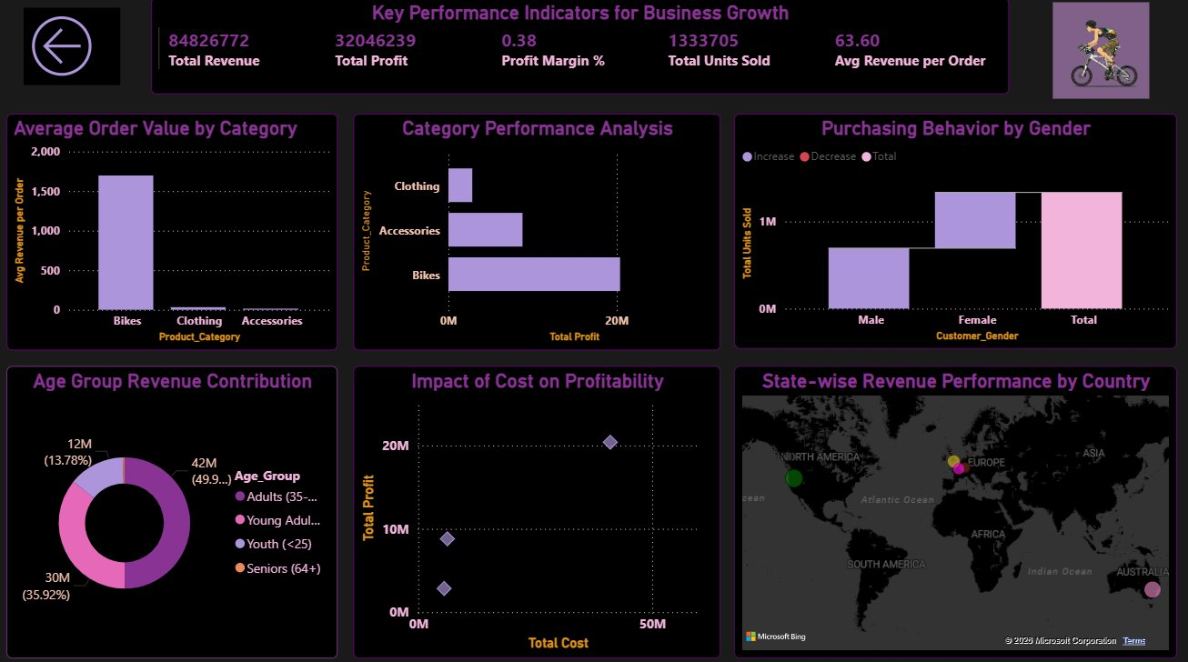
Power BI Dashboard — Page 2: KPI Business Growth
Dashboard Page 2 — Key Performance Indicators for Business Growth

Slide 19
Business Insights & Recommendations
Revenue Focus
Margin Opportunity
Bikes generate 72% of revenue. Upselling premium bike models to existing customers can maximize returns.
Accessories yield 58.6% margin. Increasing accessories marketing & bundling will improve profitability.
Geographic Expansion
Demographics Strategy
Canada and France underperform vs. US/Australia. Targeted campaigns in these markets hold growth potential.
Adults (35-64) are the core segment (50% revenue). Create loyalty programs for this key group.
Gender Equity
Underperformers
Near-equal male/female purchasing (52%/48%) — maintain gender-neutral product and marketing strategy.
Clothing has the lowest margin & volume. Consider portfolio restructuring or aggressive cost optimization.

Slide 20
Thank You!
Mountain Bike Accessories Sales Analysis Dashboard
$85.3M
37.8%
1.3M
6
Total Revenue
Profit Margin
Units Sold
Countries
Powered by Power BI | Data-Driven Decision Making | Business Intelligence
Questions? Let's explore the data together.

